Slide 1
ThEORY BEHIND RECREATIONAL DIVE PLANNER
DR VEERAJI ETTE
IDC STAFF INSTRUCTOR

Slide 2
John Scott Haldane
British Navy employed him to investigate DCS
He is credited with the models of most computer algorithms and dive tables
Based his findings on 7 concepts

Slide 3
7 Concepts
N2 dissolves from air into tissue upon descent as pressure increases
Our body continues to absorb until a state of saturation occurs
Upon ascent N2 dissolves out of the tissue into and exhaled
The difference between dissolved N2 pressure and the surrounding pressure when ascending or descending is called the pressure gradient
On ascent the tissue can tolerate some gradient of high pressure without DCS occurring, up to 2.5 times. N2 solution dissolves harmlessly out of tissue

Slide 4
7 concepts
If gradient exceeds expectable limit dissolved gas comes out of solution faster than the body can eliminate through circulation and respiration causing DCS
DCS can be avoided by keeping the pressure gradient with in acceptable limits. How?
Calculate the theoretical pressure of N2 dissolved into the body
Control the ascent so that the pressure gradient between theoretical pressure and surrounding pressure doesn’t exceed critical limits
If the gradient is too great a decompression stop is needed

Slide 5
Compartments
Different parts of the body absorbs and releases N2 at different rates
Originally the US navy tables used 5 compartments, then 6 and now 14

Slide 6
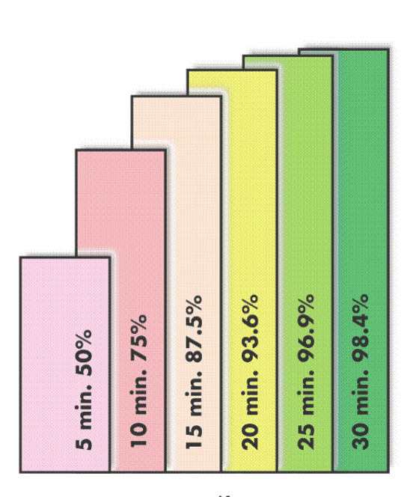
Half Times
The time in minutes for a compartment to fill ½ way
At 6 ½ times the compartment is considered to be full at 98.4%
Today models use 3 minutes and up to 600 minutes ½ times compartments
Compartments with short ½ times are fast tissues
Compartments with long ½ times are slow tissues

Slide 7
M Value
Maximum tissue pressure allowed in a compartment when the diver surfaced to prevent exceeding the maximum acceptable gradient
If you exceed the M-Value you might succumb to DCS
Fast Compartments have High M Value
Slow Compartments have Low M Value
RDP is designed on test dives and dive data
Doppler ultrasound detects very small silent bubbles that don’t cause DCS

Slide 8
Various compartments

Slide 10
Terminology
Bottom Time is the time from start of descent to start of ascent, excluding time to ascent and safety stop
Multilevel dive is a dive that starts at a depth and then progresses to a shallower depth for a time period
NDL is No Decompression Limit. The Maximum amount of time allowed at a depot before having to do a decompression stop
Pressure group is a letter that represent the amount of N2 in your body. A is a little and Z is a lot.
Repetitive dive is a dive with in 6 hours of a previous dive

Slide 11
Terminology
RNT is residual nitrogen time, which is the amount of N2 expressed in minuted for the planned depth already in your body from a previous dive
Safety stop is a stop at 5 meters for 3 minutes

Slide 12
US Navy Tables
Commonly used until 1980
Realized that any compartment could be the controlling compartment
Navy used 120 minutes ½ times compartment for surface interval
This meant that any dive within 12 hours was a repetitive dive

Slide 13
US NAVY Demographic back then
Male, Tall, fit aged between 20-30 yrs of age.
Where as recreational divers comes in all variants

Slide 14
Dr Raymond Rogers
Came in about 1980
Realized that as a 120 minutes ½ time for calculatin washout when deco diving is overtly conservative for No Deco Diving
Test group of US Navy was not the recreational diver of today
Doppler Ultrasound flow meter was developed

Slide 15
RDP
Surface interval credit can be less conservative when limited to No Deco Diving
60 minutes ½ time compartment is used as analysis showed than 120 minutes ½ time was overtly conservative for No Deco Diving
RNT is roughly cut in half compared to US navy table offering short surface intervals between dives
The RDP has 14 compartments and 5 minutes to 480 ½ time

Slide 16
RDP
Compartments slower than 60 minutes could control a repetitive dive for a small portion of NO stop dives, involving long shallow multiple dives
This is why if in pressure group W and X a 1 hour surface interval is mandatory for every subsequent dive
Y and Z pressure groups require a 3 hours minimum surface interval between repetitive dives
The RDP has lower M values
NDL for single dive on RDP are shorter than US navy Table
CANNOT INTERCHANGE PRESSURE GROUPS

Slide 17
Rules
Cold water or strenuous 4 meter deeper
Plan repetitive dives shallower
Limit max depth to experience and training
Multiple repetitive dives W and X = 1 hour SI
Multiple repetitive dives Y and Z = 3 hours SI
Limit repetitive dives to 30 meters
42 meter is for emergency only

Slide 18
Rules
If you descend to 40 meters or More or exceeded NDL by less than 5 minutes ascent to 5 meters for 8 minutes stop and dont dive for 6 hours
If a NDL is exceeded by more than 5 minutes ascent to 5 meters and wait for 15 minutes air supply permitting. Don’t dive for 24 hours
Do a safety stop after every dive(recommended), must do one if dive is 30 meters or deeper or within 3 PG of NDL

Slide 19
Rules for diving at High Altitudes
Altitude if higher than 300 meters above sea level
Do not dive in higher than 3000 meters
Ascent rate 9 meter per minute
Must do safety stop at theoretical depth
No more than 2 dives per day
Acclimatize for 6 hours to release N2 or add 2PG
Don’t go to higher altitude after 1st Dive

Slide 20
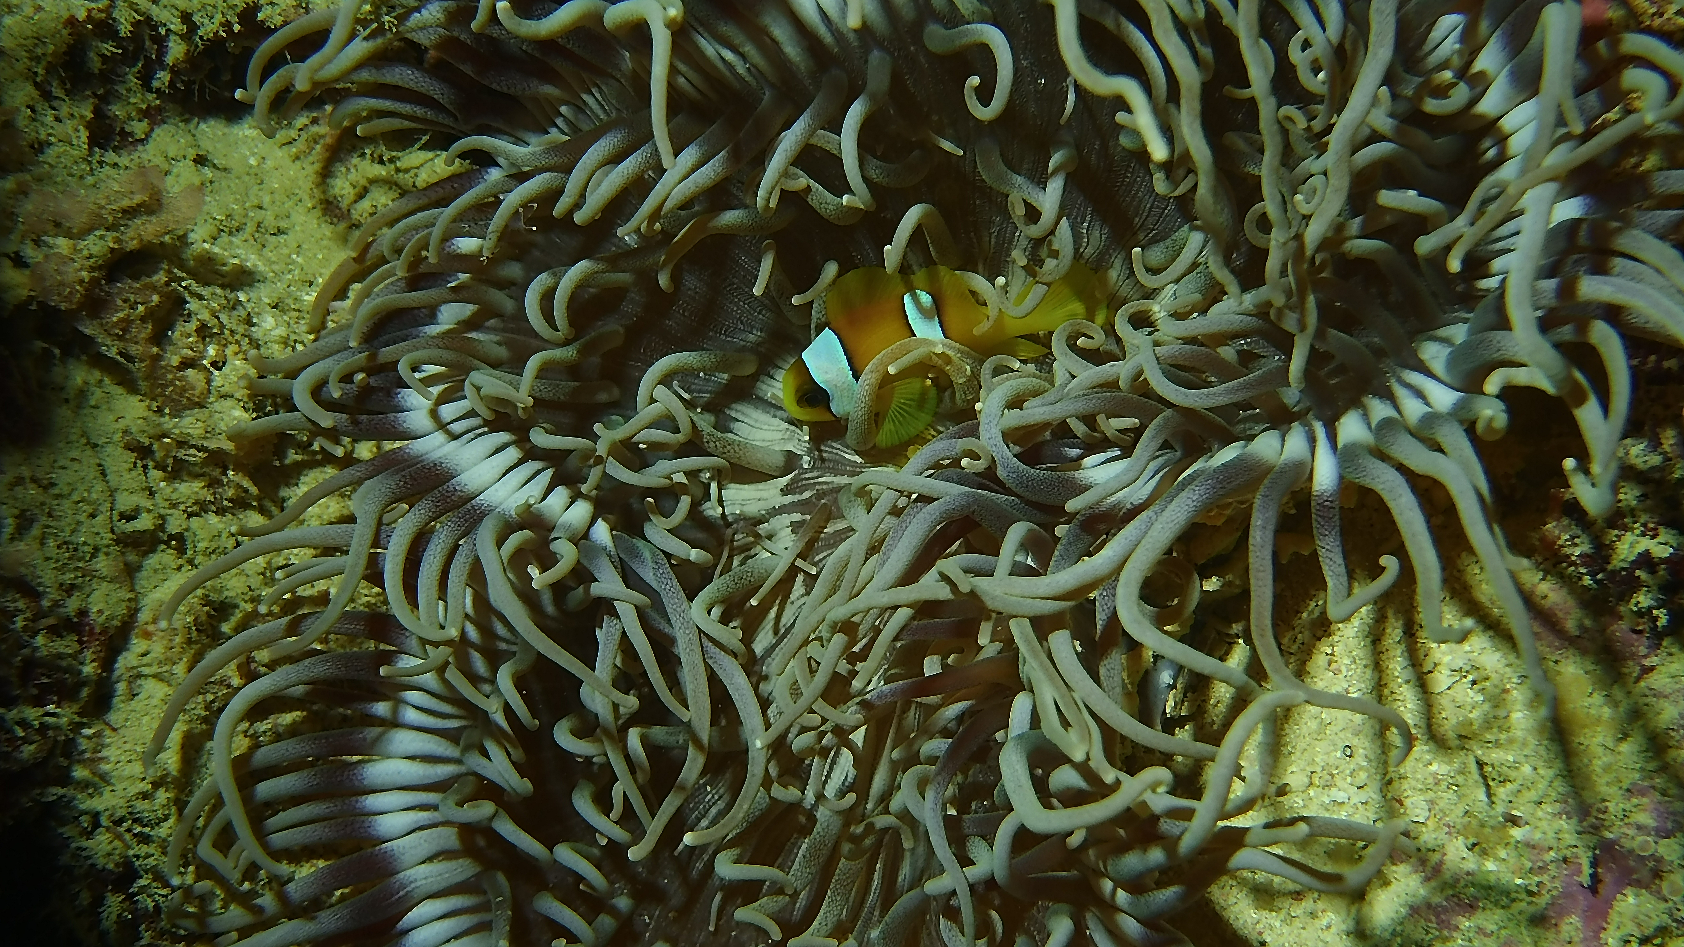
Thank you

